Slide 1
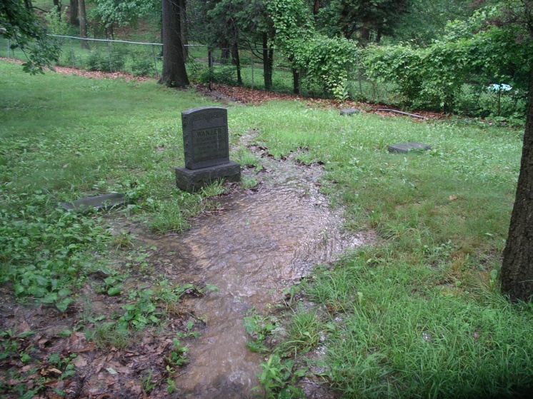
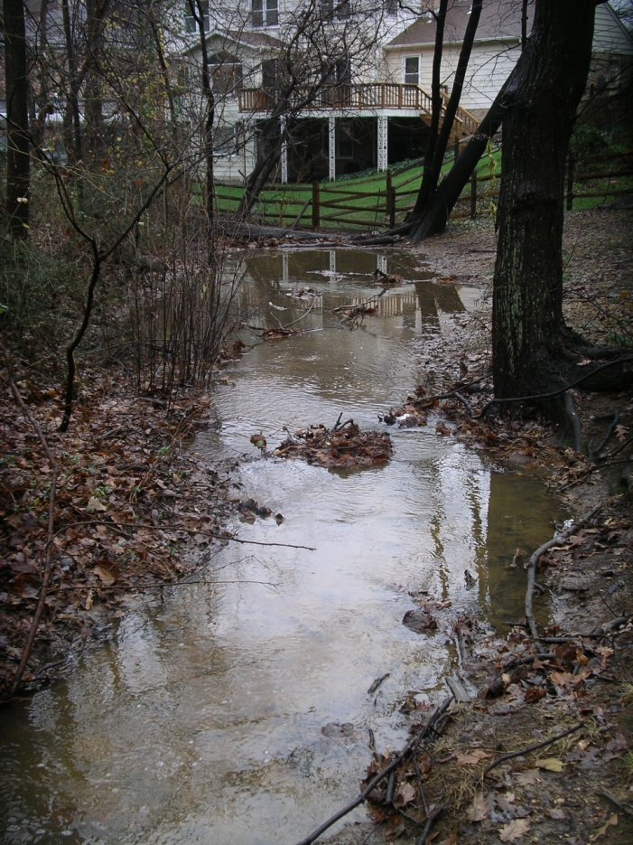
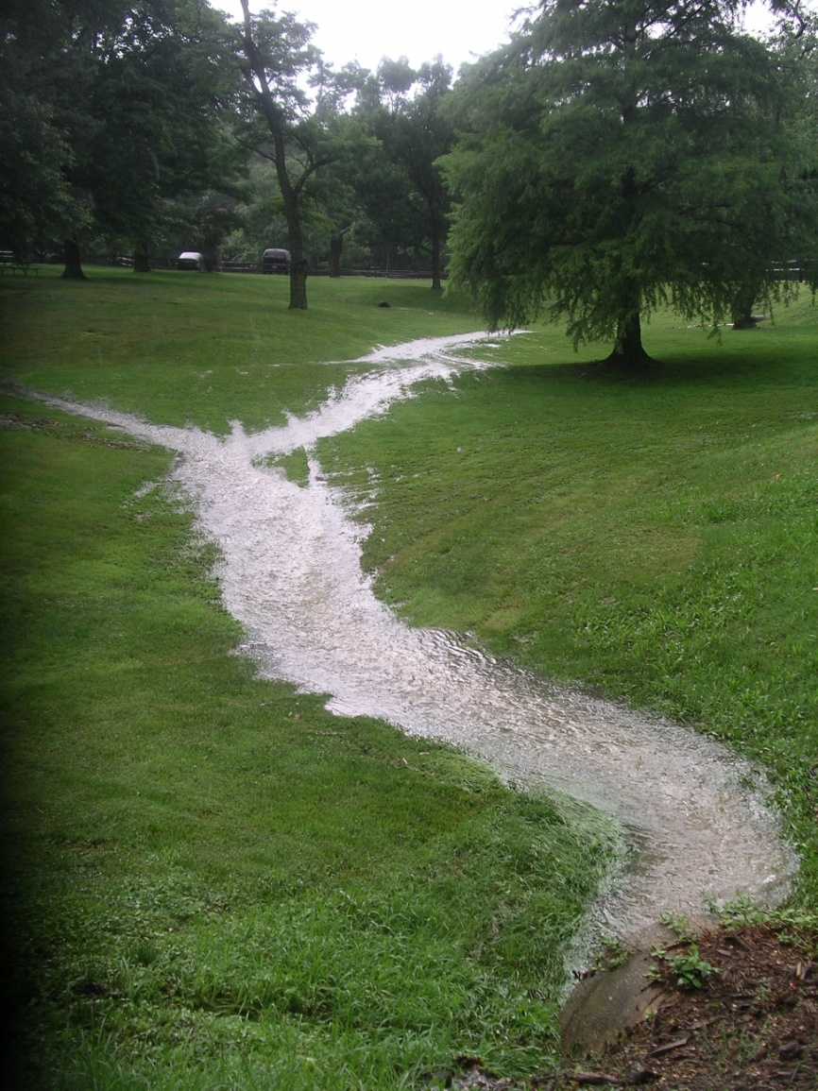
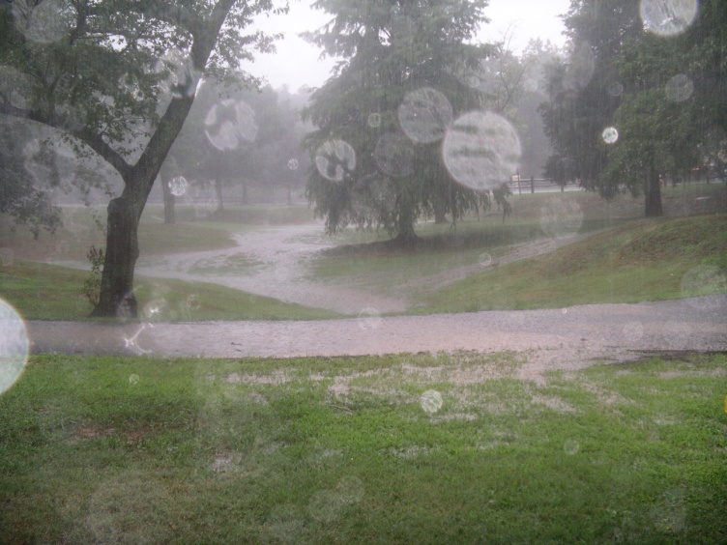
Fort Ward Park Storm Water Problems
Community Impact
SHA Area 6 rep Glenn Eugster sent the photos below to the Mayor and City Council as well as the City staff and the Fort Ward Park Advisory Group. Councilman Rob Krupika responded on June 7, 2010, “Thank you, Glenn. I completely agree this is something that needs to be fixed. As our economy improves, we can add more funding to address this need, along with many others in the city related to flooding and storm water.”
Oakland Cemetery (above) and sheet flow from Braddock Road/Museum toward Van Dorn St (below & bottom right).
McCormick residence in Marlboro Estates (above)

