Slide 1
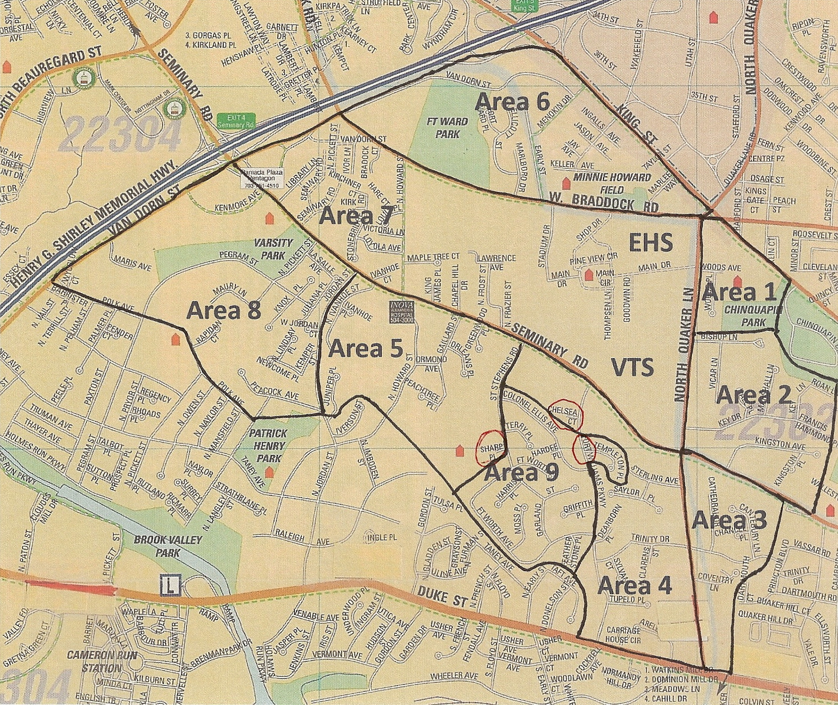
Seminary Hill Association, Inc.
SHA is a non-partisan, non-profit civic organization that promotes the
general welfare of the residents of the City of Alexandria,
particularly those who live in the Seminary Hill area.
2115 Marlboro Drive
Alexandria, VA 22304
www.seminaryhillassn.org
SHA President
Nan Jennings
(H) 703-820-6930
nrjennings@comcast.net

