Slide 1
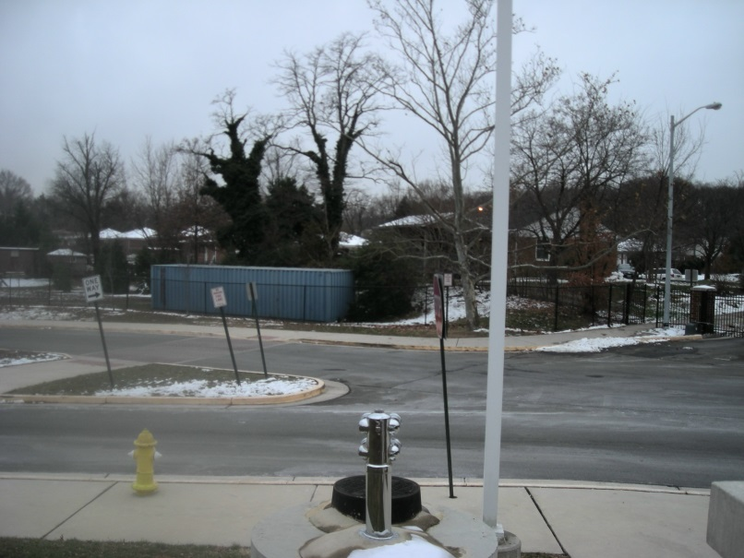
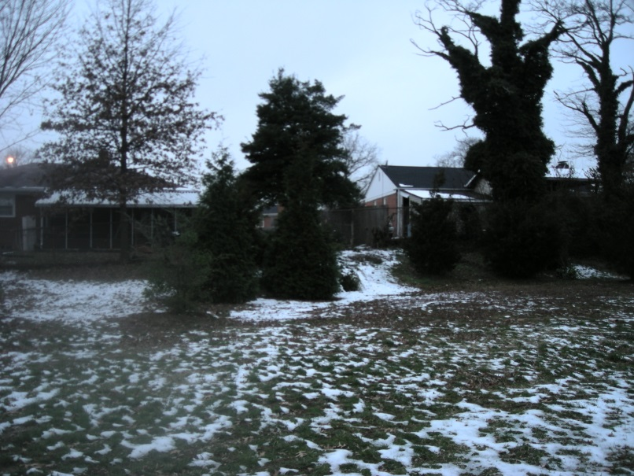
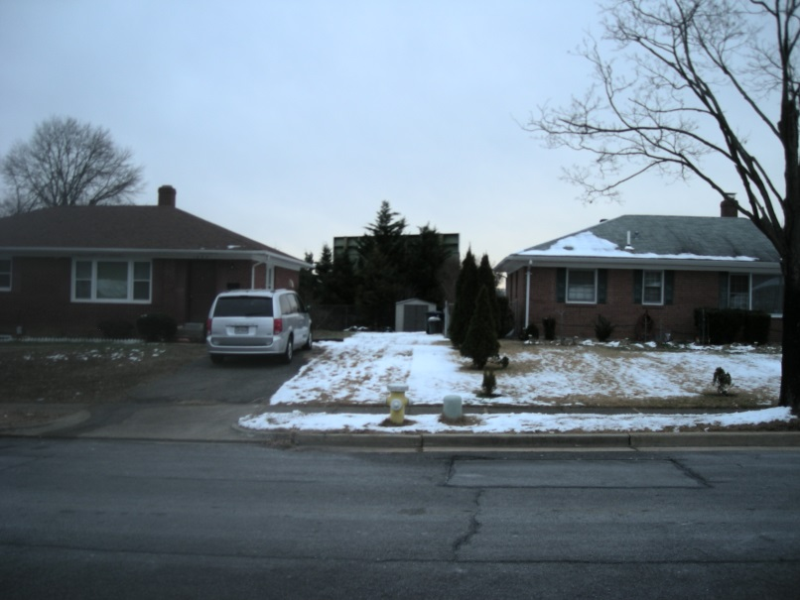
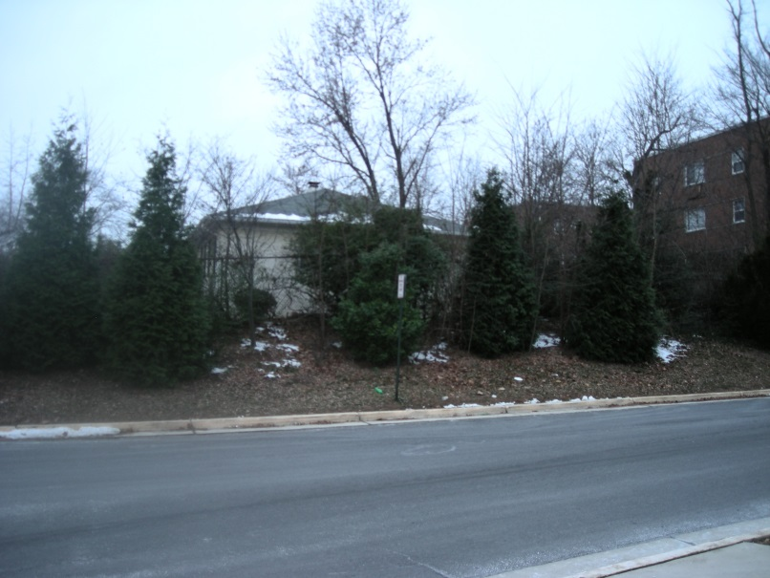
Screening - 14 December 2013
Woods Place
Woods Place
Football Scoreboard from Woods Place
3401 Woods Avenue

Slide 2
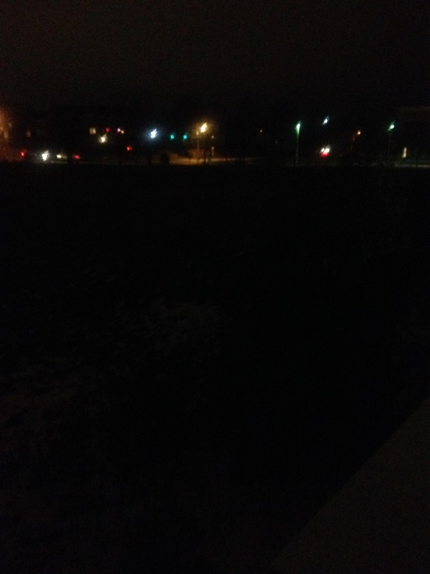
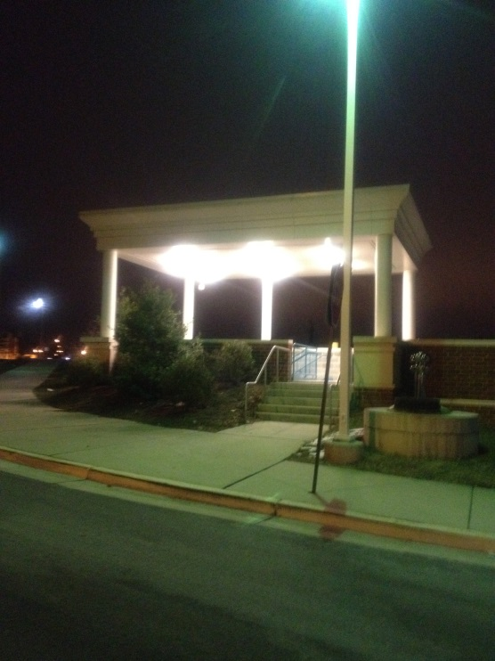
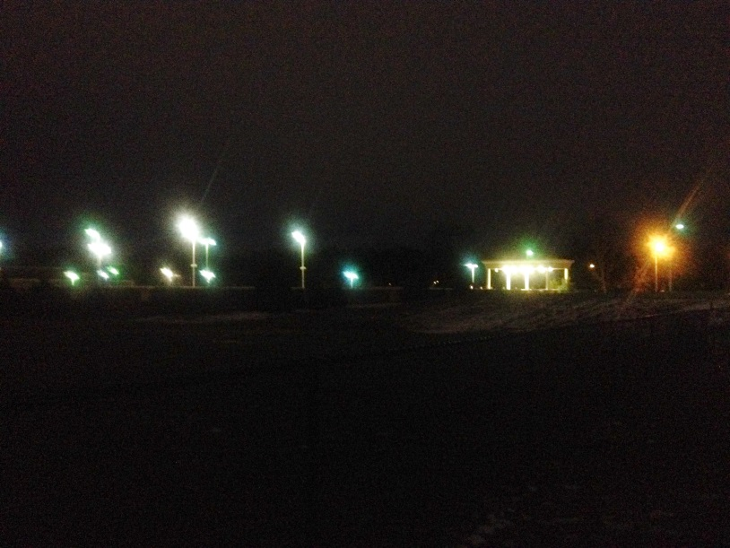
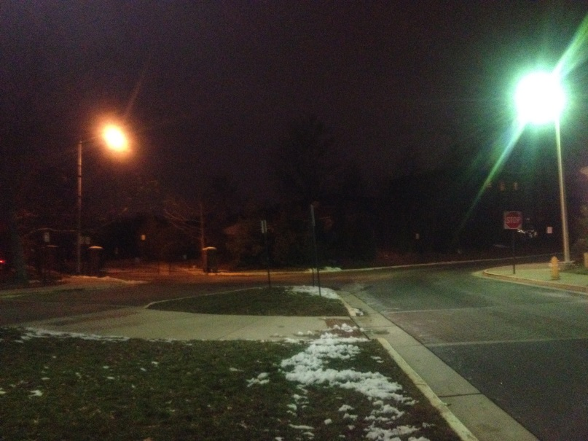
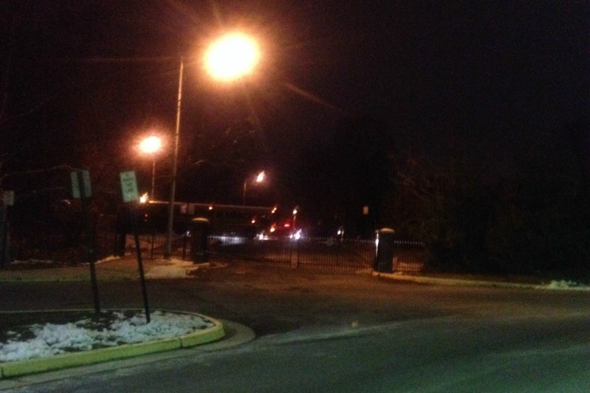
Lighting - 14 December 2013
View toward King Street
Stairs shine on Woods Avenue
View toward Woods Place and Woods Avenue
3401 Woods Avenue is across from stairs
Left: School bus on Woods Avenue at 6:35 AM on 14 Dec 2013 . . . TCW gate closed, so the bus turns around ; backs up—b eep, beep, beep—on a Saturday morning!
Note: these people did not move to a neighborhood with a school.

Slide 3
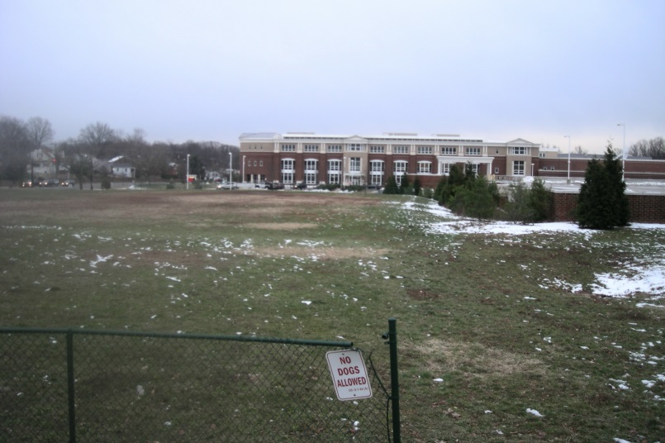
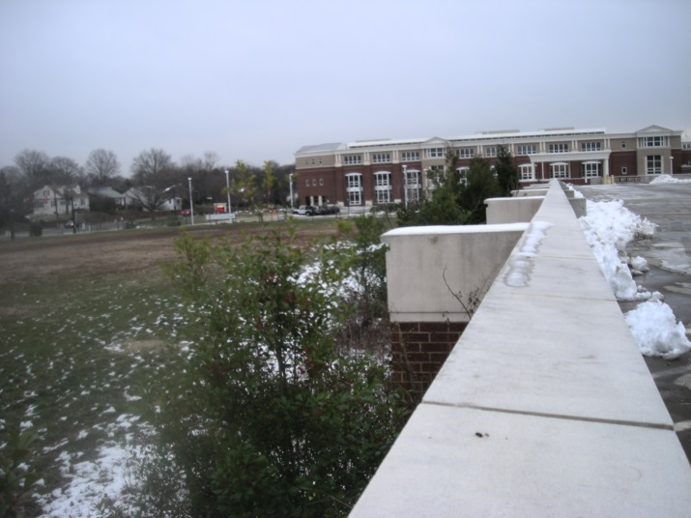
Location of Proposed Tennis Courts - 14 December 2013
King Street playing field
From the parking garage

