Slide 1
Quaker Lane & Seminary Road/ Janney’s Lane
March 14, 2013

Slide 2
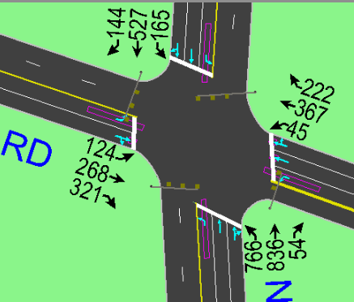
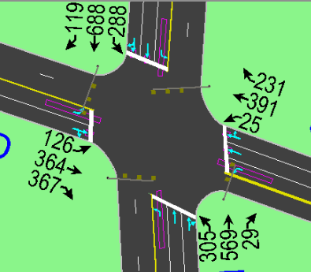
Current Conditions
AM Peak Hour Volumes
PM Peak Hour Volumes
Seminary Rd
Seminary Rd
N
N
Quaker Lane
Quaker Lane

Slide 3
Safety Concern this Proposal Will Address
Seminary Road
Janneys Lane
N
Quaker Lane

Slide 4
Proposed Lane Configuration Change
Seminary Road
Janneys Lane
Quaker Lane

Slide 5
Analysis of Proposals
Level of Service Analysis
SEMINARY RD. & QUAKER LN. | AM Peak Hour LOS- HCM |  |  |  |  | PM Peak Hour LOS- HCM
 | EB | WB | NB | SB | Overall | EB | WB | NB | SB | Overall
Existing Conditions | F | E | E | E | F | F | D | E | E | E
Proposed | F | D | F | E | F | E | C | E | E | E
Proposed – Barn’s Dance | F | D | E | E | E | D | C | E | E | E

Slide 6
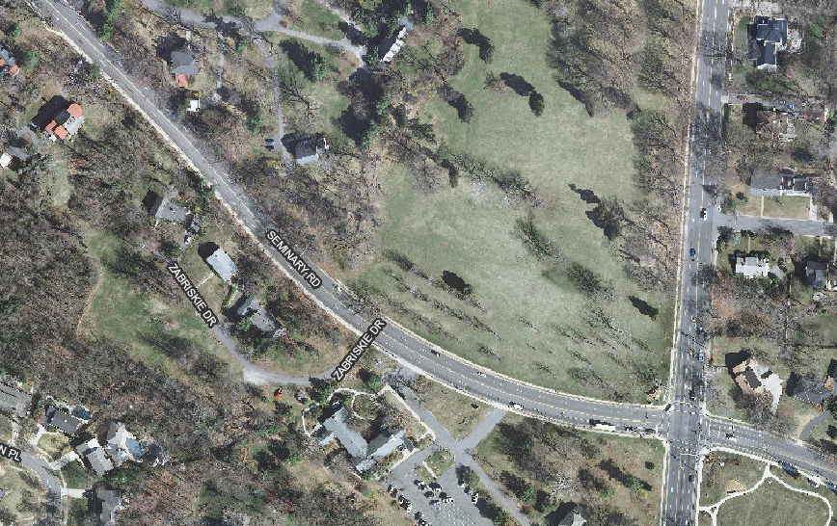
Effects on Eastbound AM Queue Lengths
Existing Queue
Proposal Queue
Eastbound Queue

Slide 7
Effects on Eastbound PM Queue Lengths
Existing Queue
Proposal Queue
Eastbound Queue

Slide 8
Queue Analysis
SEMINARY RD. & QUAKER LN. | AM Peak Hour Queue Length 95th - Synchro
 | EBL | EBT | EBR | WBL | WBT | WBR | NBL | NBT | SBL | SBT
Existing Conditions | 171 | 1092 | n/a | 88 | 392 | n/a | 1357 | 506 | 148 | #588
Proposed | n/a | 846 | 23 |  | 417 |  | 1415 | 523 | 155 | 576
Proposed – Barn’s Dance |  | 724.0 | 118.0 |  | 343 |  | 1149.0 | 408.0 | 115.0 | 485.0
SEMINARY RD. & QUAKER LN. | PM Peak Hour Queue Length 95th - Synchro
 | EBL | EBT | EBR | WBL | WBT | WBR | NBL | NBT | SBL | SBT
Existing Conditions | 141 | 1173 | n/a | 39 | 351 | n/a | 540 | 401 | 389 | 655
Proposed |  | 869 | 34 |  | 323 |  | 551 | 407 | 412 | 655
Proposed – Barn’s Dance |  | 699 | 194 |  | 243 |  | 442 | 336 | 261 | 521

Slide 9
Questions?

